Slide 1
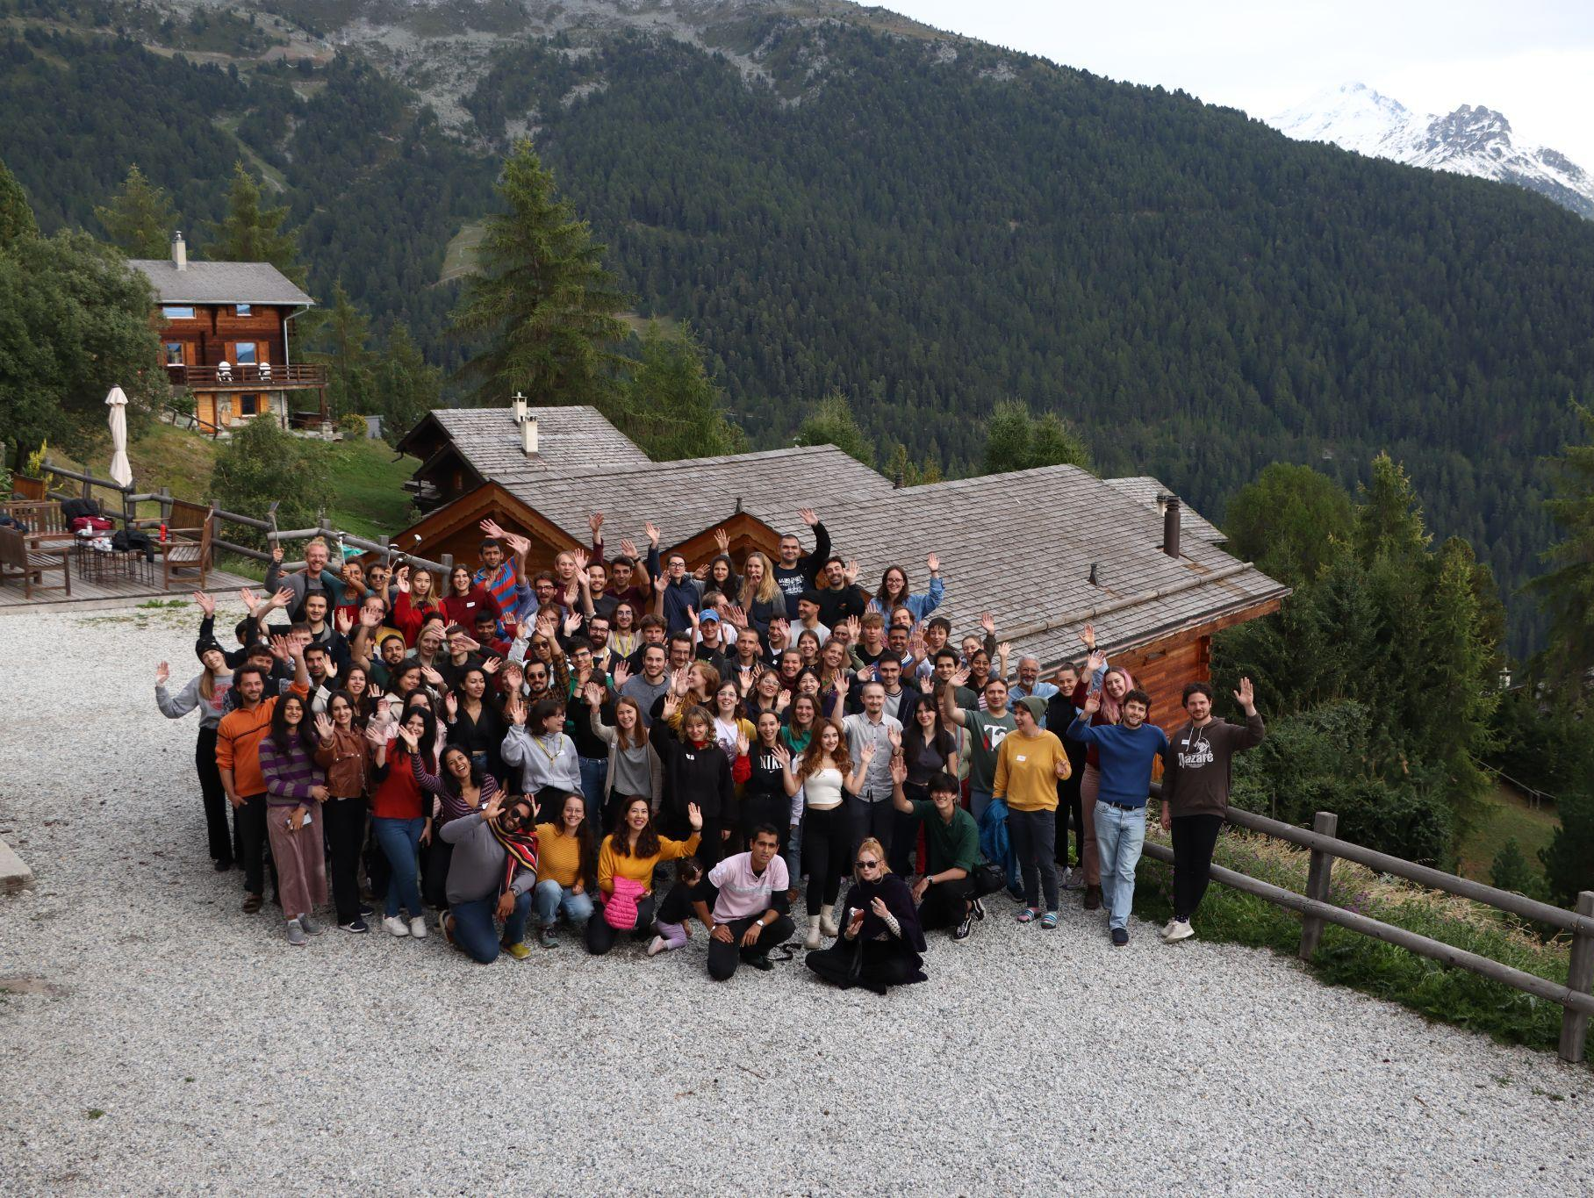

Rethinking Economics
Genève

Slide 2
Rethinking Economics, c’est quoi?
Rethinking Economics est un réseau international d’étudiant.e.x.s qui se rassemblent pour promouvoir une nouvelle manière d’enseigner et de pratiquer l’économie, dans le but de la rendre plus apte à gérer les enjeux actuels (comme le réchauffement climatiques, les inégalités…)
Notes:
The Rethinking Economics Movement emerged around 2011. As a reaction of crisis, particularly the 2008 financial crisis, and the inability of the economic teaching to critically reflect and adapt, economic students around the world connected with the goal to find answers to the questions the current economic teaching did not provide them with. How can an economic teaching/narrative that has led to financial crises, climate crisis, growing inequality should be able to solve those issues? Luckily there is more out there than what has been part of the economics curricular. Since then RE fights for Curricular Change aiming for Plurality of Theories, Methods and interdisciplinary. All over the world local and regional groups emerged. For example under the roof of Rethinking Economics Switzerland 8 local groups exists. One of them is us.

Slide 3
Et à Geneve?
Notes:
Well, now you might say: but I am doing already a heterodox master - why is Rethinking Economics relevant here?
First of all - every program can be improved
Second - there is still a mainstream economics programme
But in general we see Rethinking Geneva more as a space for our own ideas and discussions - and with Rethinking Economics as a mother organization and being a student association there are quite a few advantages (funds, rooms etc.)
this was the idea when we (re)founded the geneva chapter - to have a space for our own debates/interests and to put some focus on the interesting stuff happening here at our faculty
As I said there is a lot of room for your ideas (already heard about a possible reading circle on Marx’s Capital) - we would like to present what we did in the past year.

Slide 4
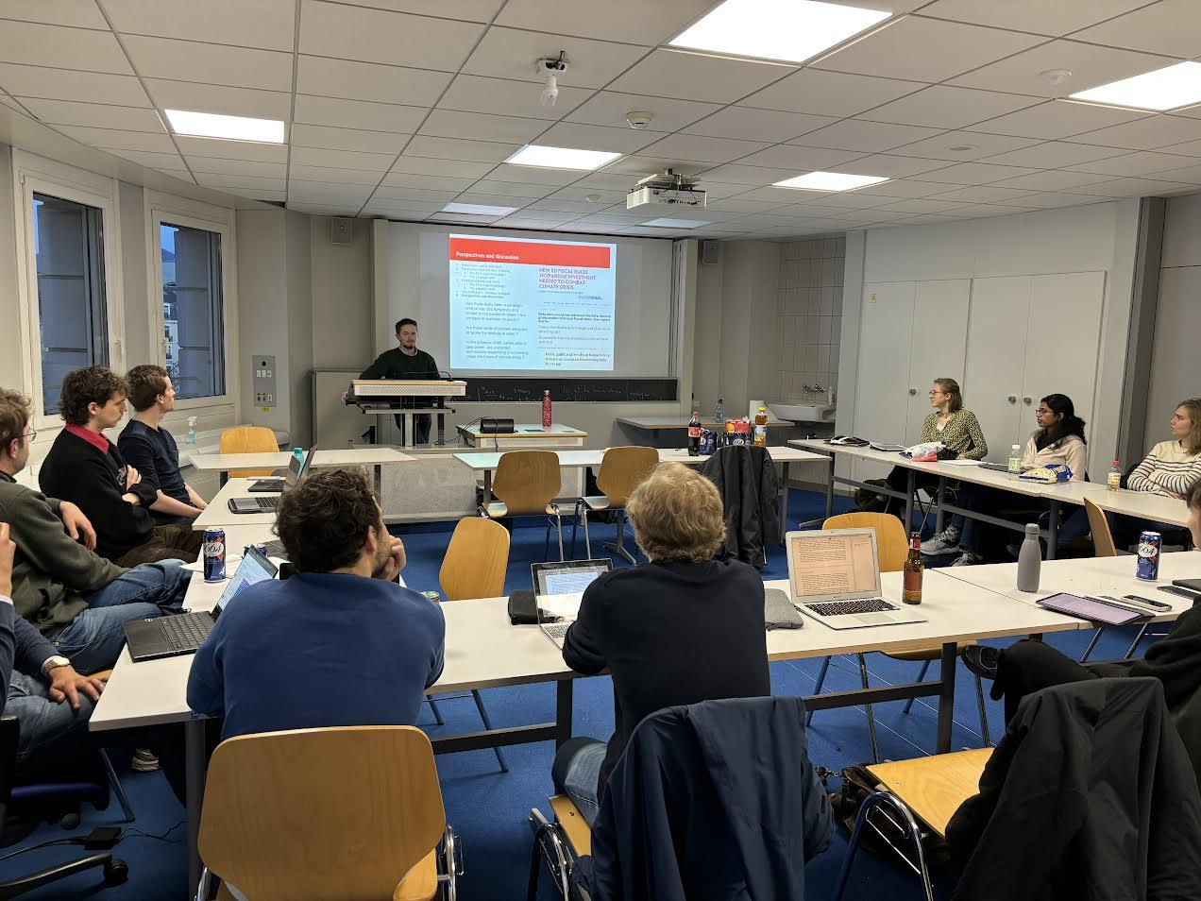


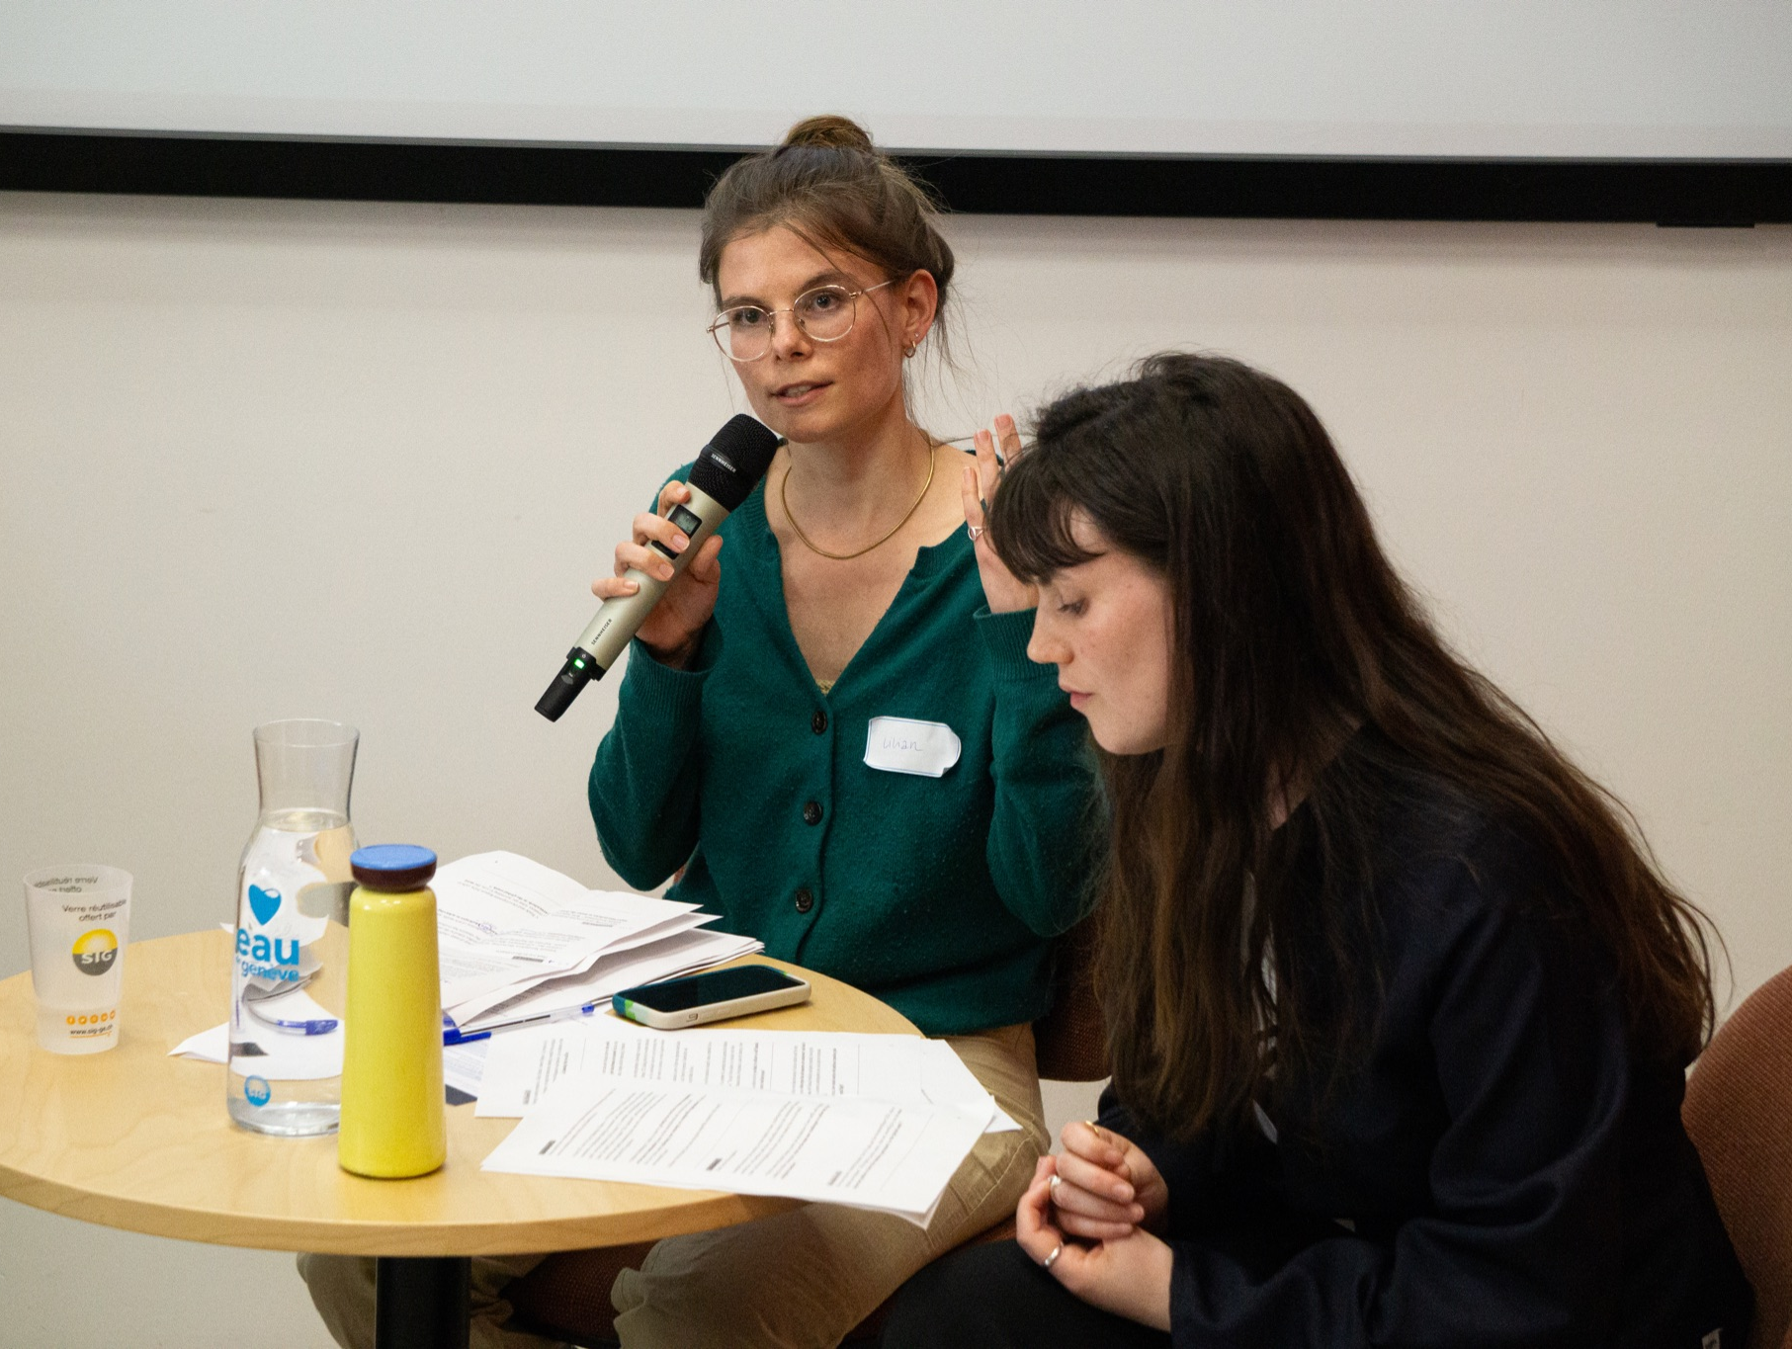
Cercles de lecture
Programme
du semestre
Projections de documentaires
Printemps 2025
Conférences, apéros
Notes:
We had reading circles on topics we find interesting:
One semester we read papers on financing the ecological transition - with papers from daniela gabor, Jens van’t kloster and many more, mostly one person being in charge of the discussion and with a little introduction,
we watch movies together - last semester (l’homme a mangé la terre) or we went together to watch tax wars at a film festival with a panel
we also have workshops provided by us as well as by professors: e.g. on the evolution of the economic discipline or on the methods of hiding wealth from a RE member who has a background in that field (Adnan), Mark Morgan, you probably just met, was presenting his work on the relativity of fiscal space even before the paper was published - you see you will get the hot infos even before they are official - at that event about 40 participants attended

Slide 5
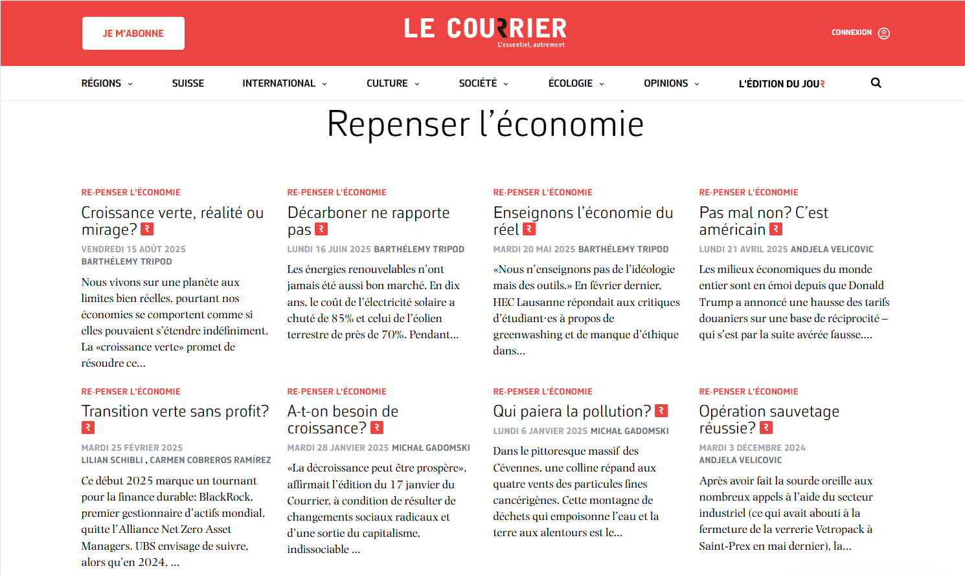
Chronique dans Le Courrier
Chaque mois
Sujet à choix
Relecture collective
Notes:
One of the main ideas, when we created RE Geneva, was to get some outreach for heterodox student voices. So we are very happy to have a column every two month in the newspaper le courrier. We encourage all of you to join as this is a great opportunity to improve our writing skills and to make the points that are important to us on a public stage.

Slide 6
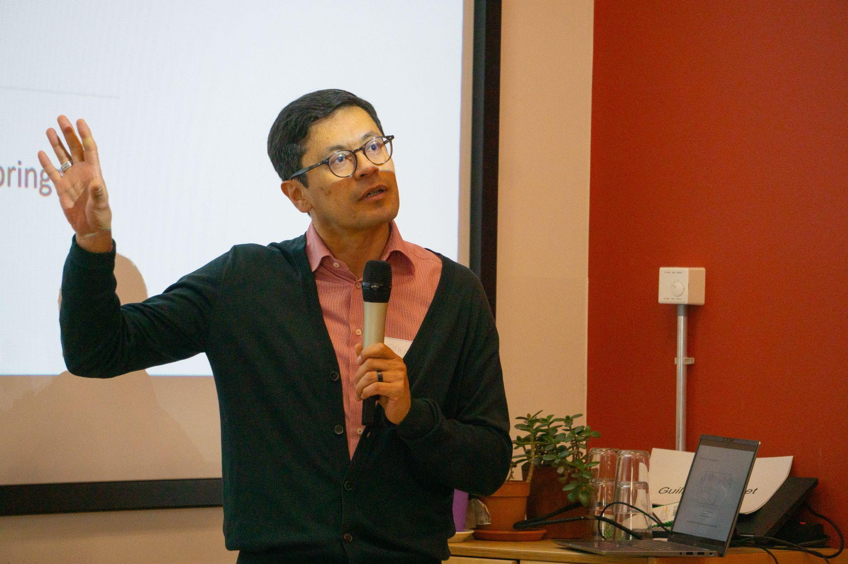
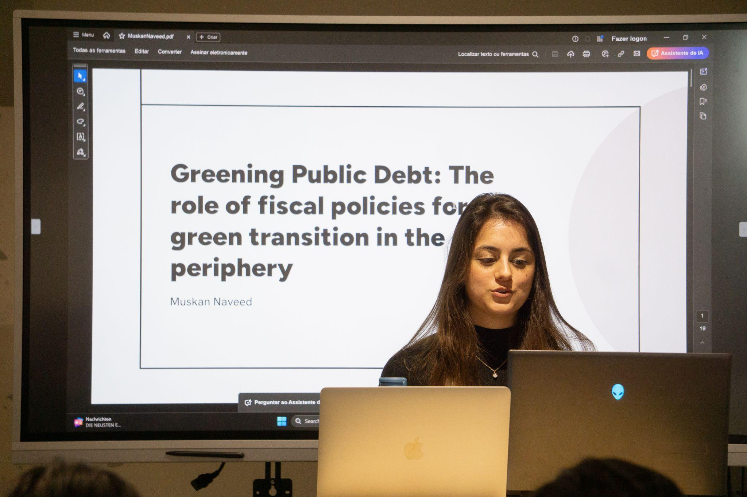
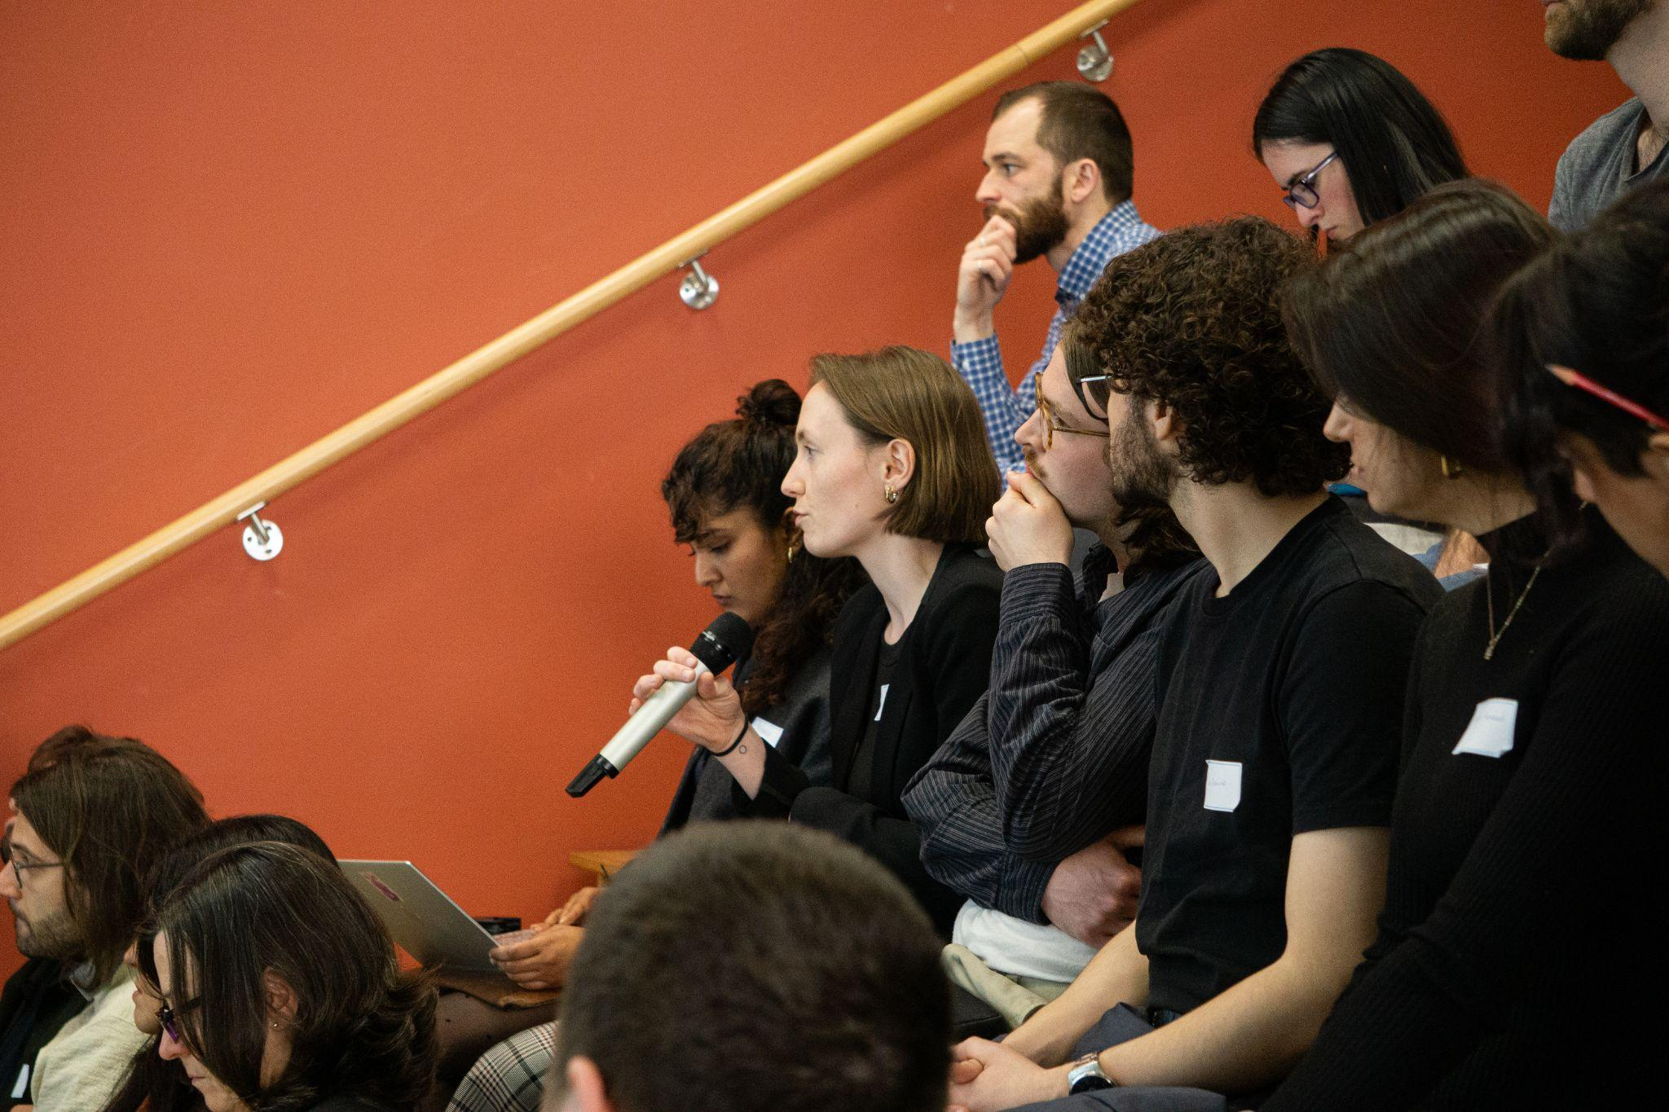
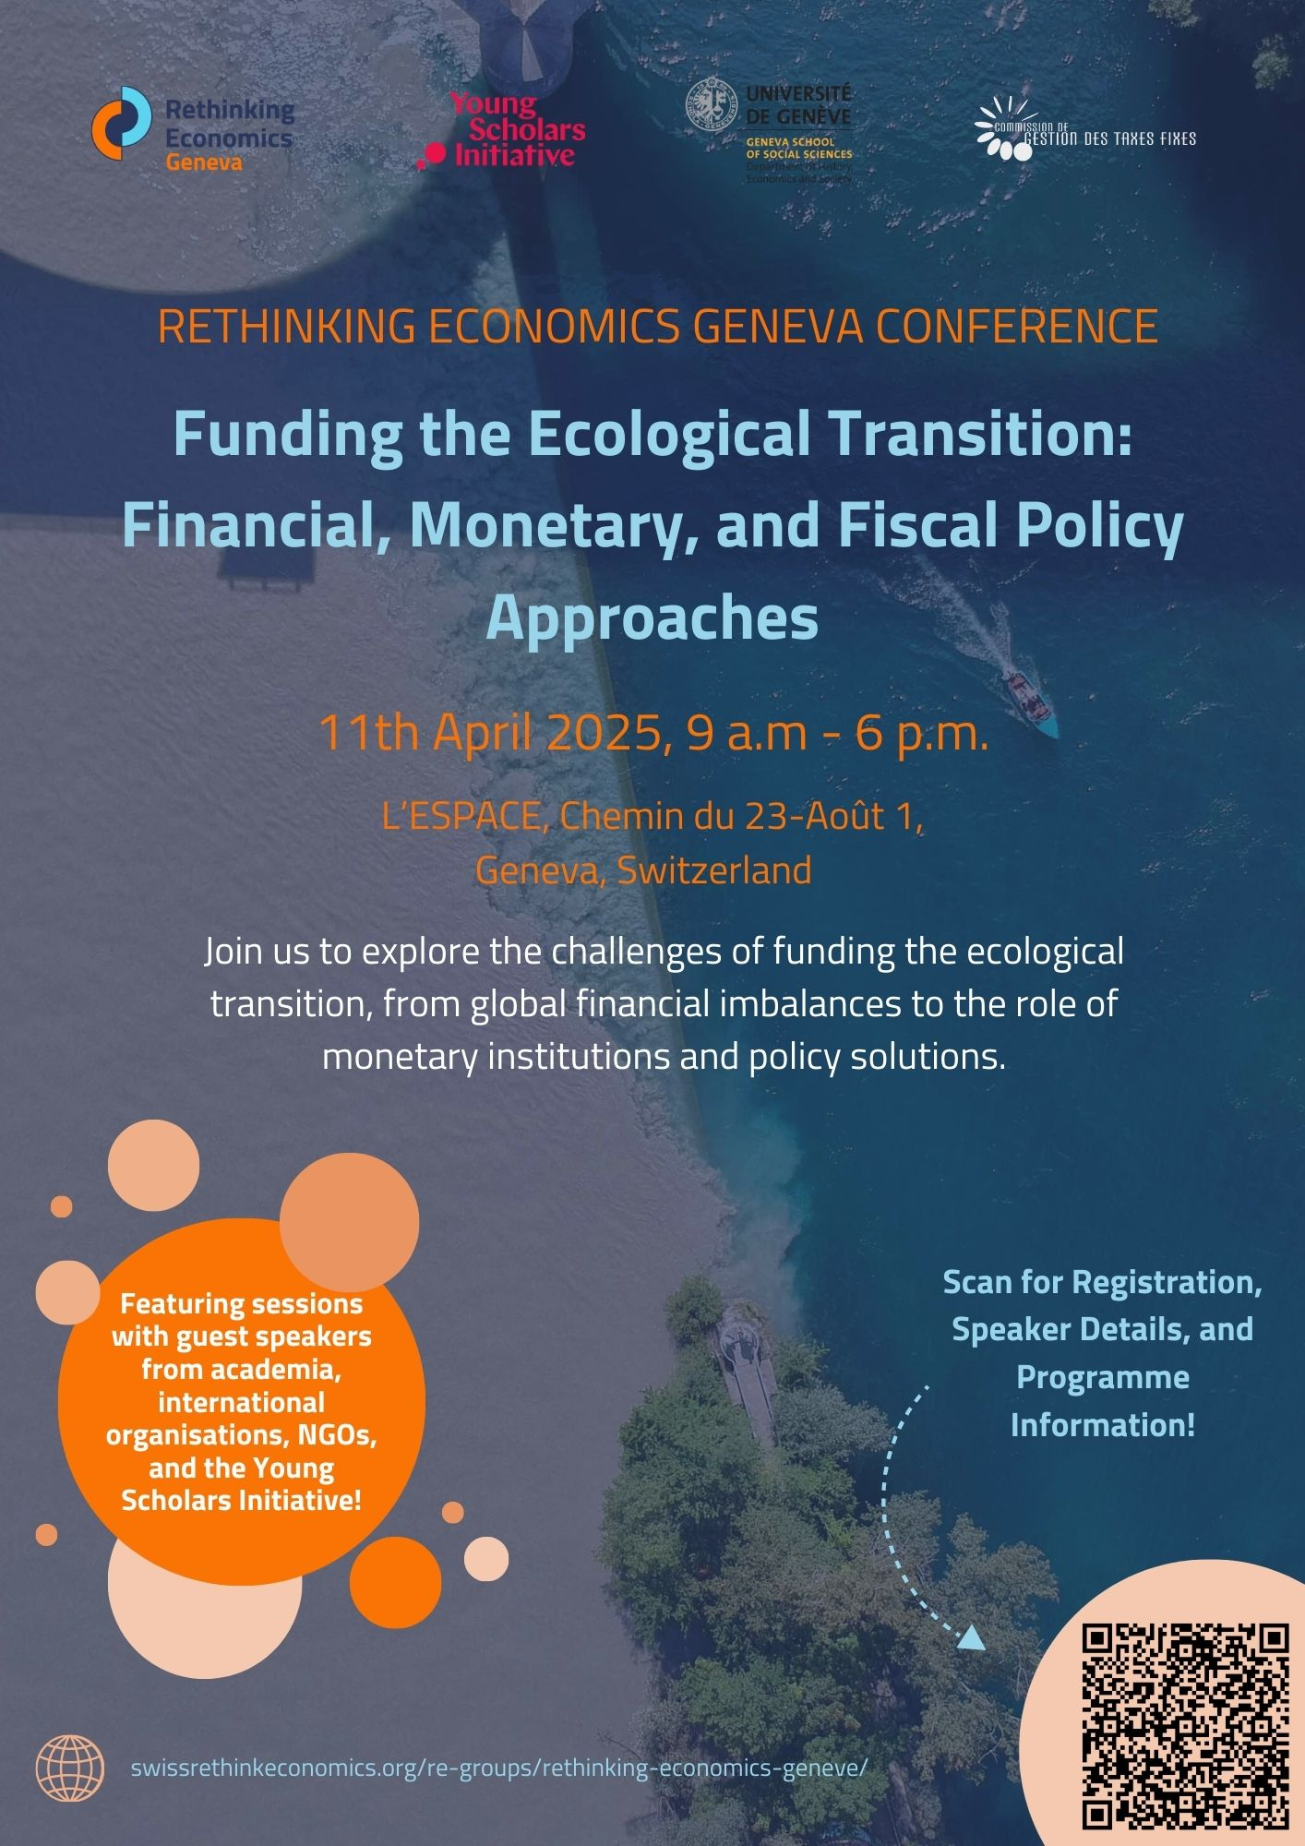
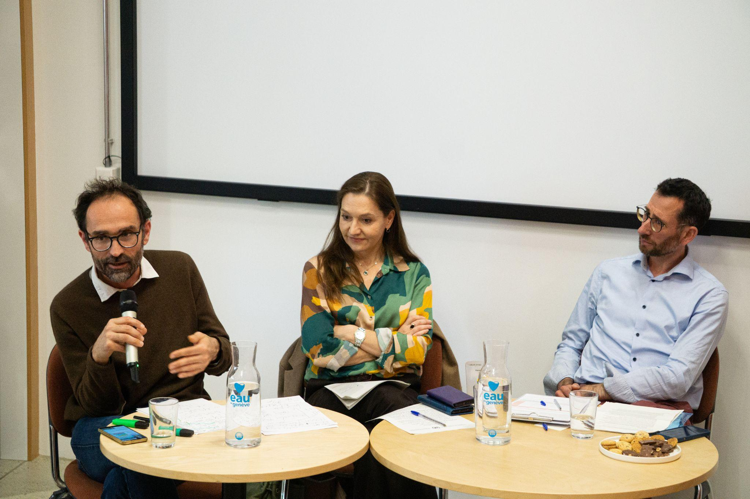
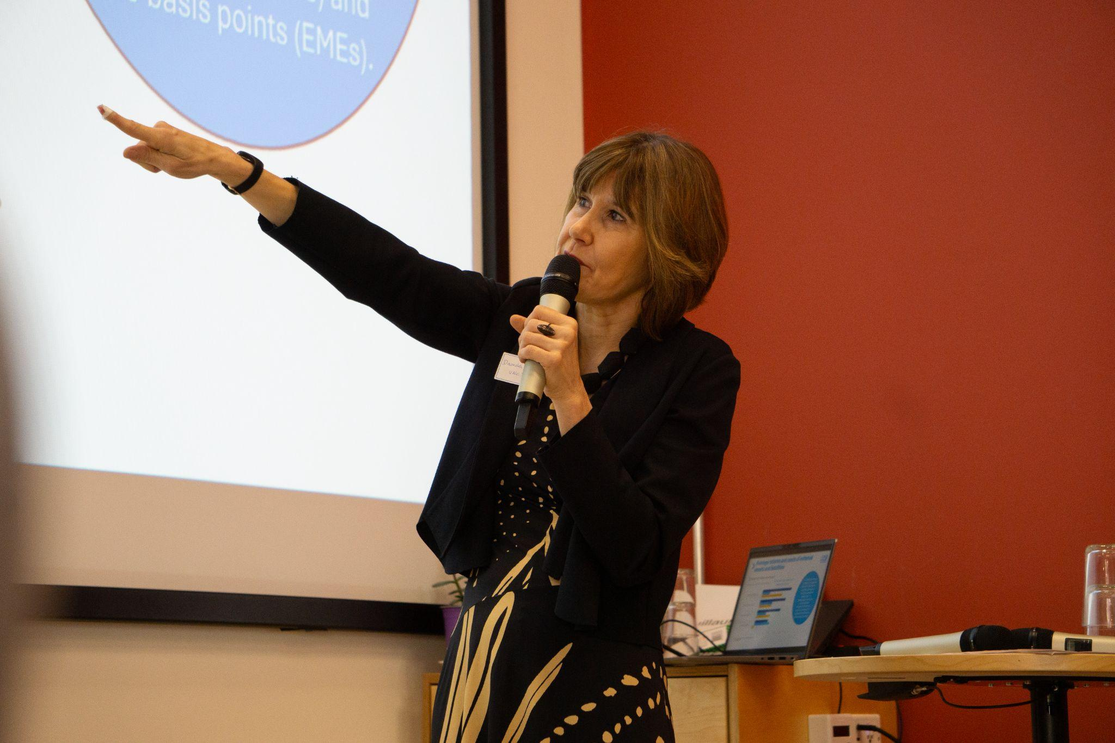
RE Geneva Conference
2025
plus de 70 participants
18 présentateurs
16 Presentations d’étudiant.e.x.s
Collaboration avec le DEHES, YSI et RE Switzerland
Notes:
The third big pillar of our work last year was a conference on Funding the ecological transition. It was quite a lot of work but we managed to get a program together including speakers from our University (Juan Flores, Marc Morgan, and Cedric Durand), UN Trade and Development e.g. Daniela Prates, someone from the WWF, and many more. The conference also hosted a Young Scholar Session in collaboration with the Young scholar Initiative - with students and PhDs presenting their work and getting feedback from Professors and other experts.
We had a welcome dinner the night before, we had a nice apero, many people from different countries, different programs and with different backgrounds attended and for me this was one of those wholesome moments when you realize that there is actually quite a lot of really smart and nice people working on those relevant issues.

Slide 7
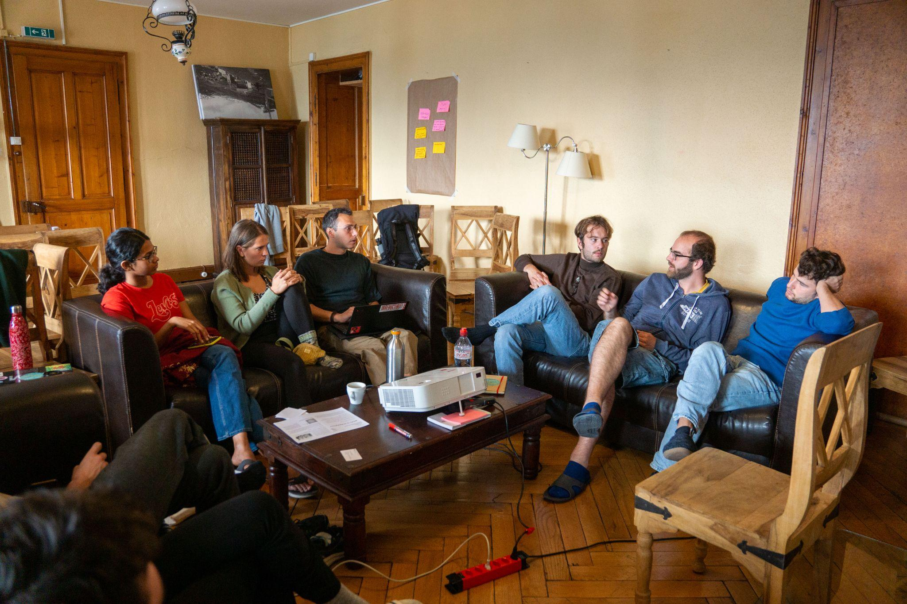
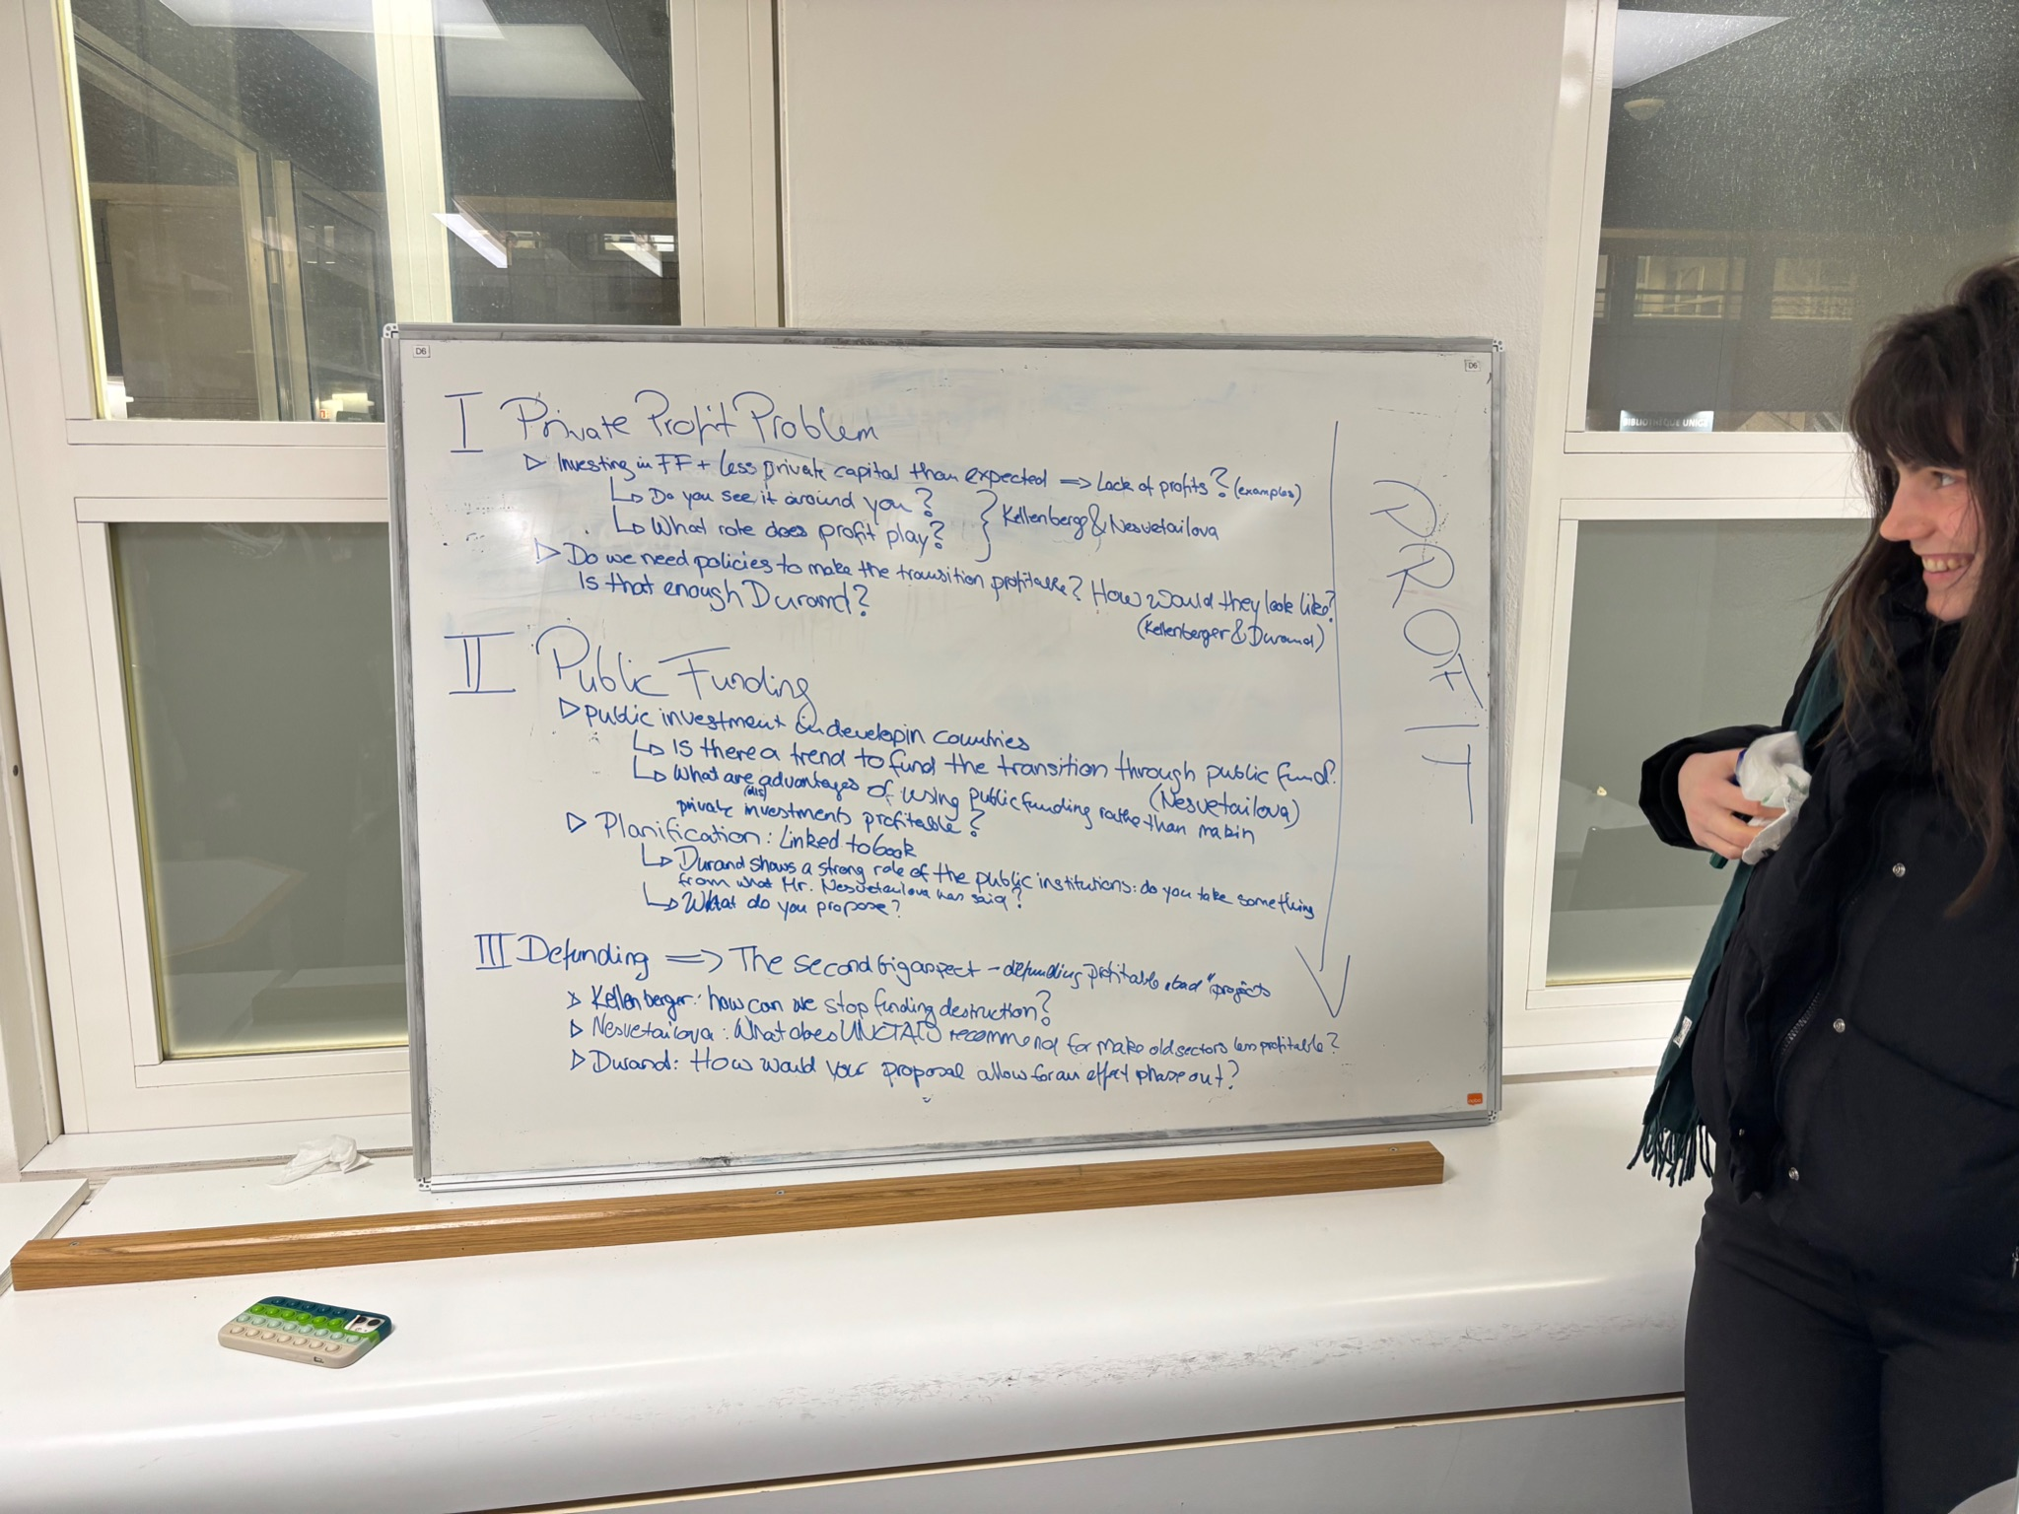

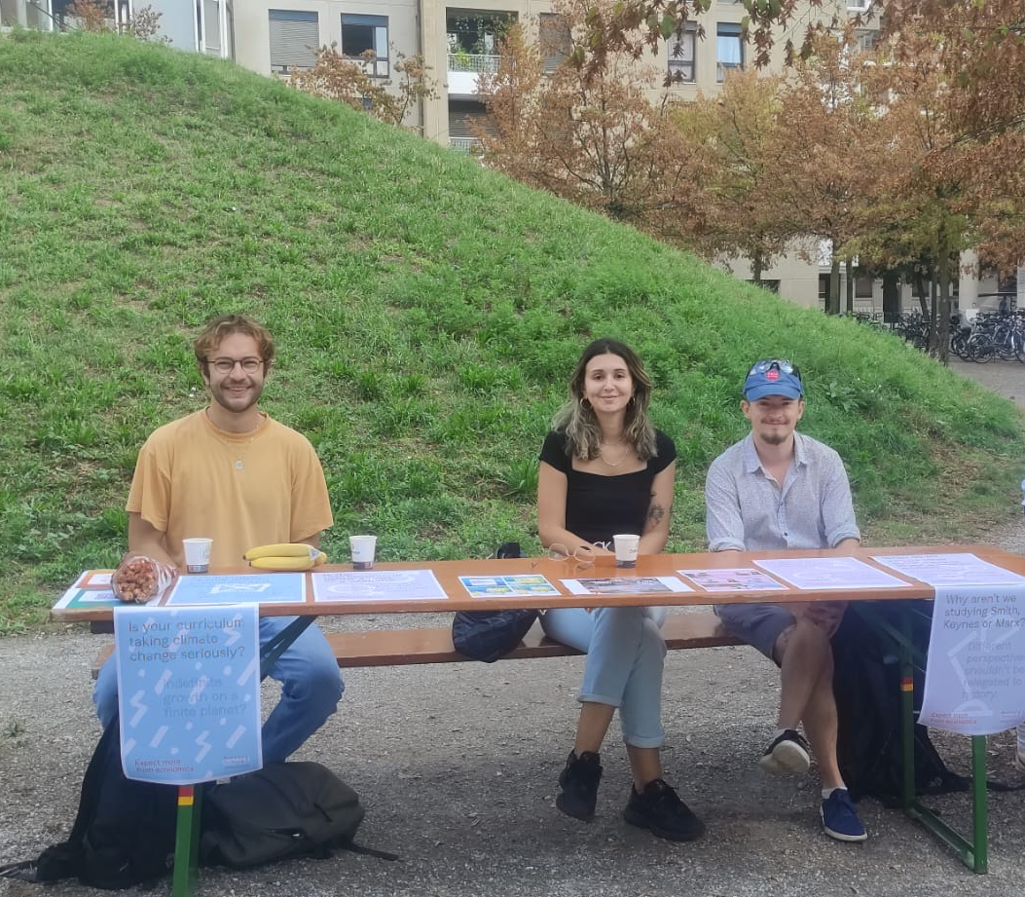
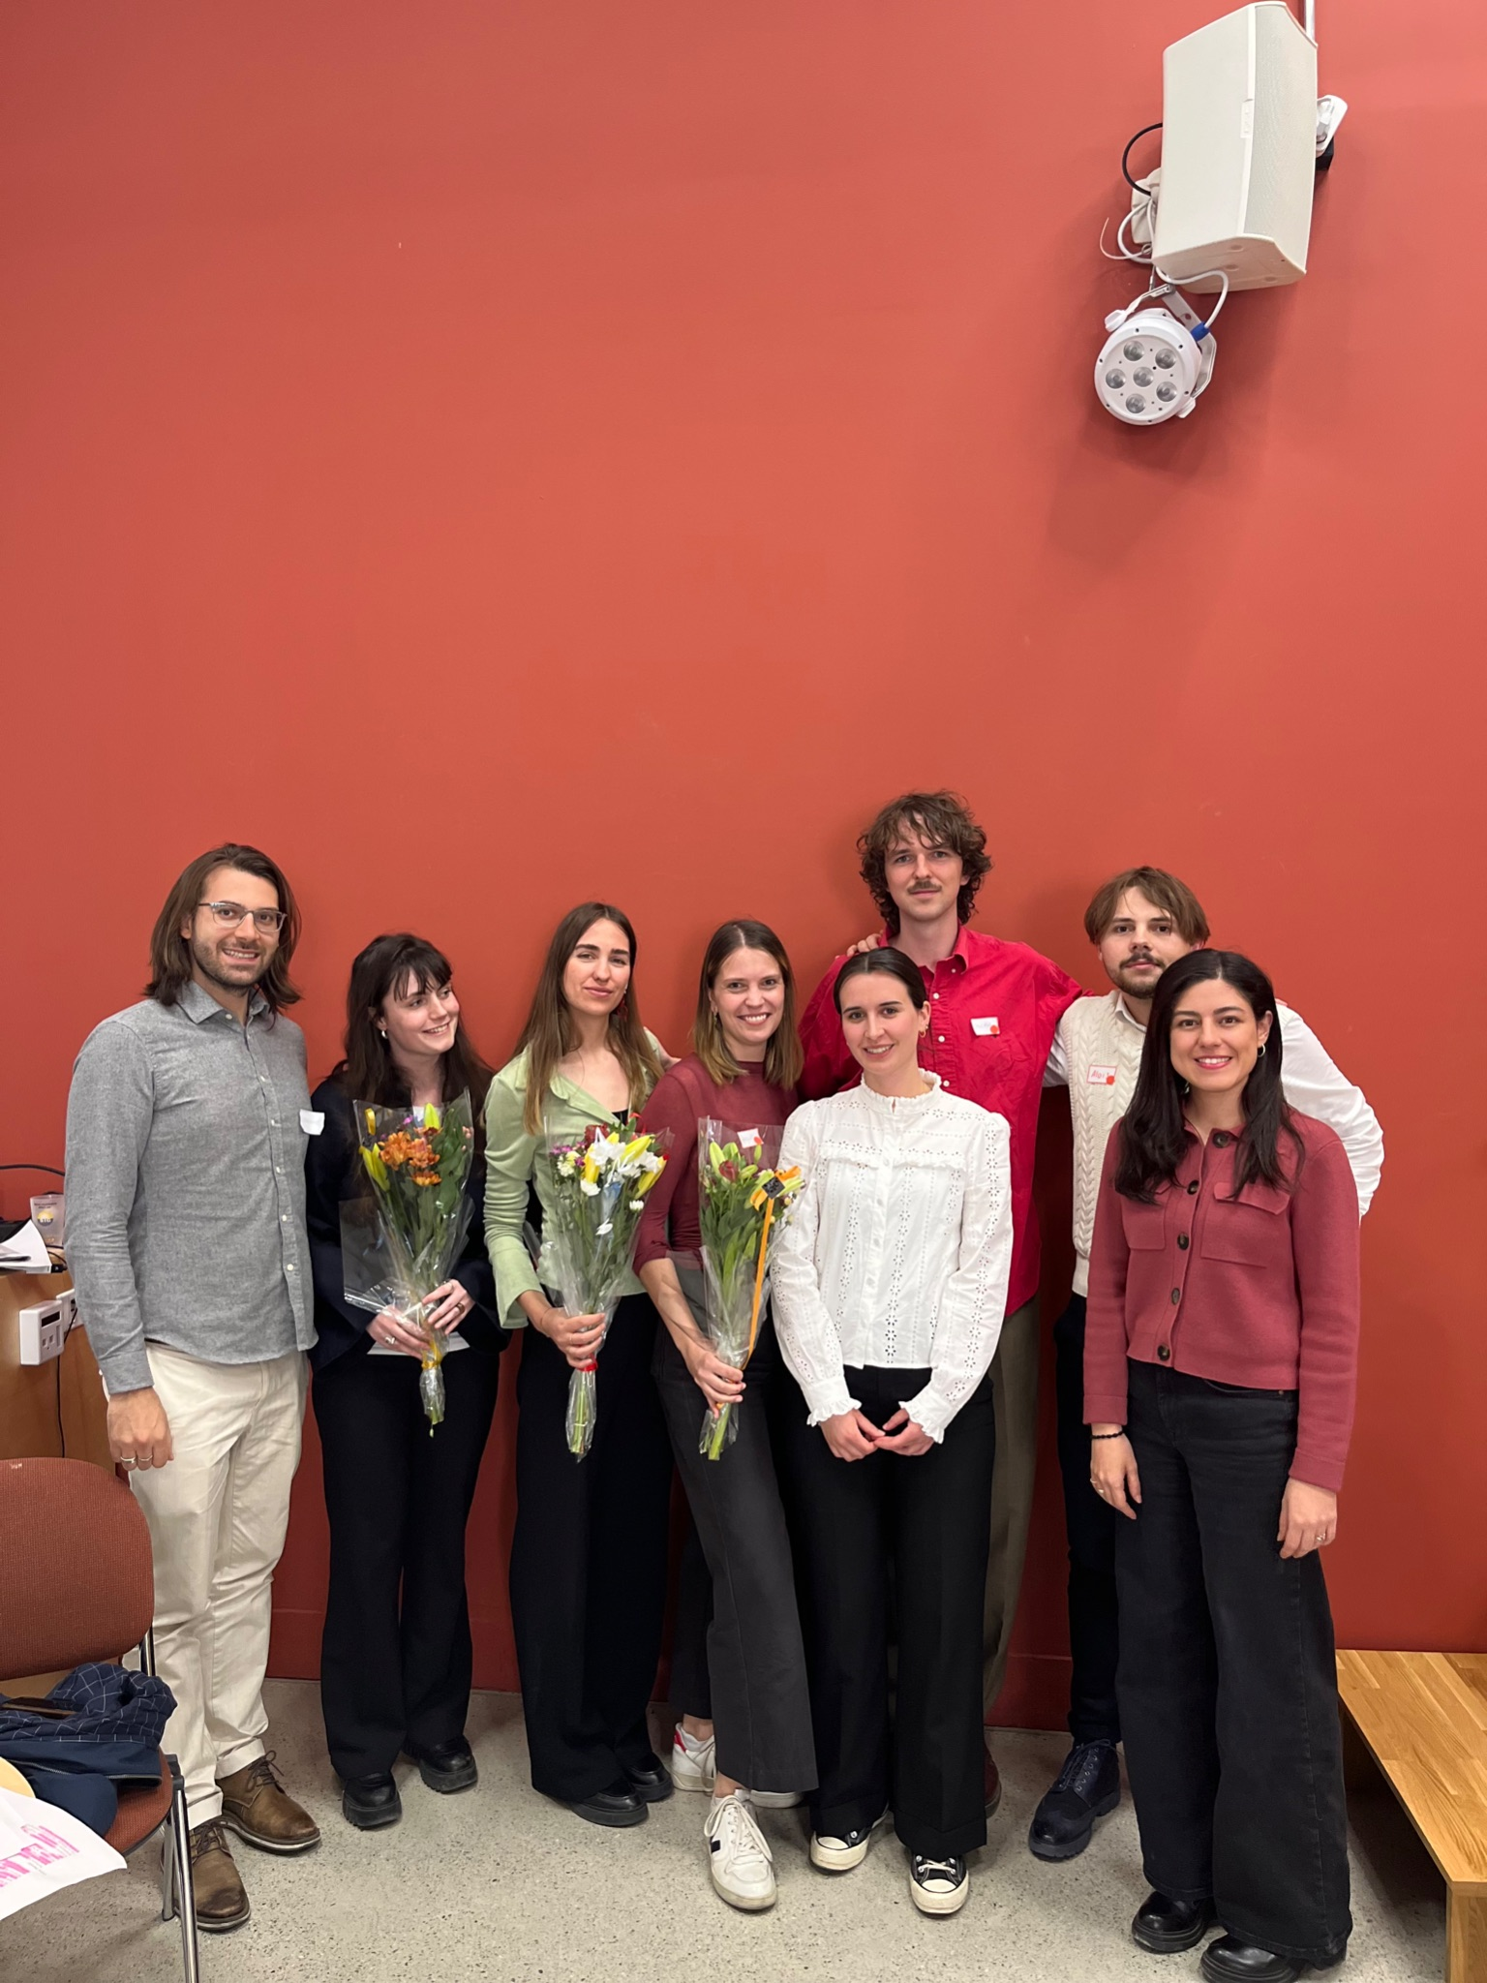
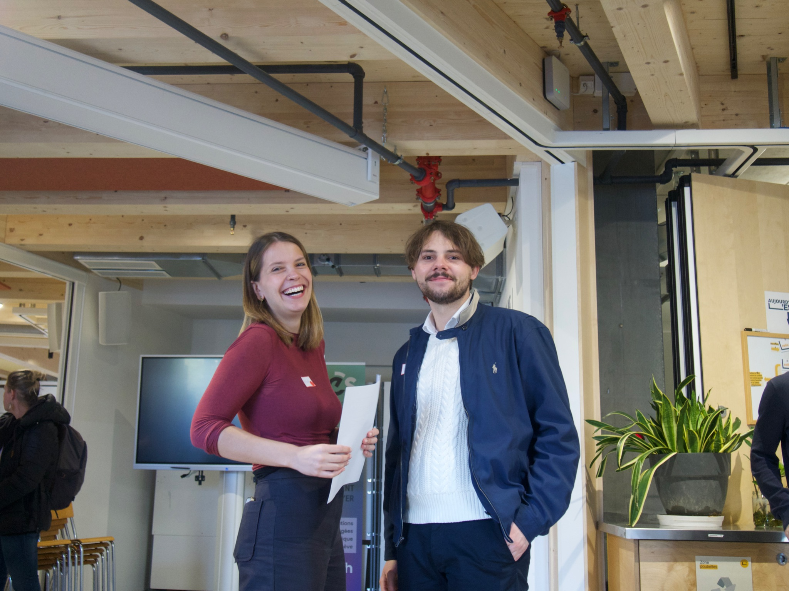
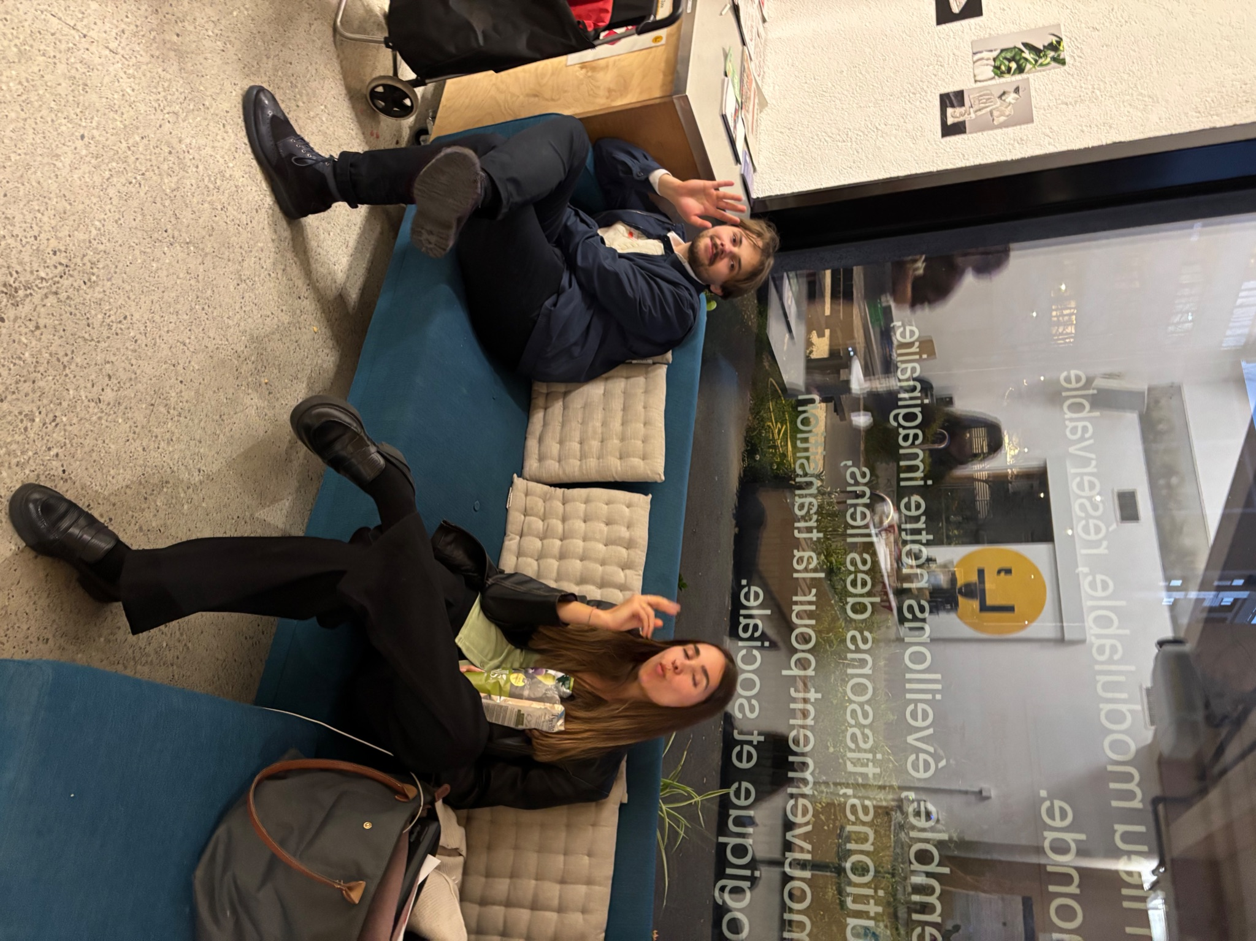
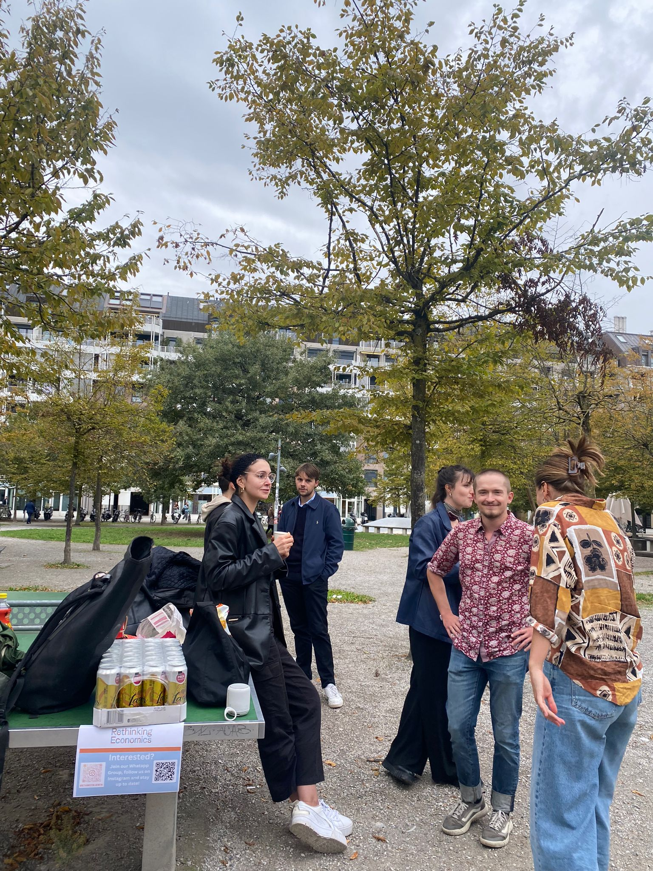
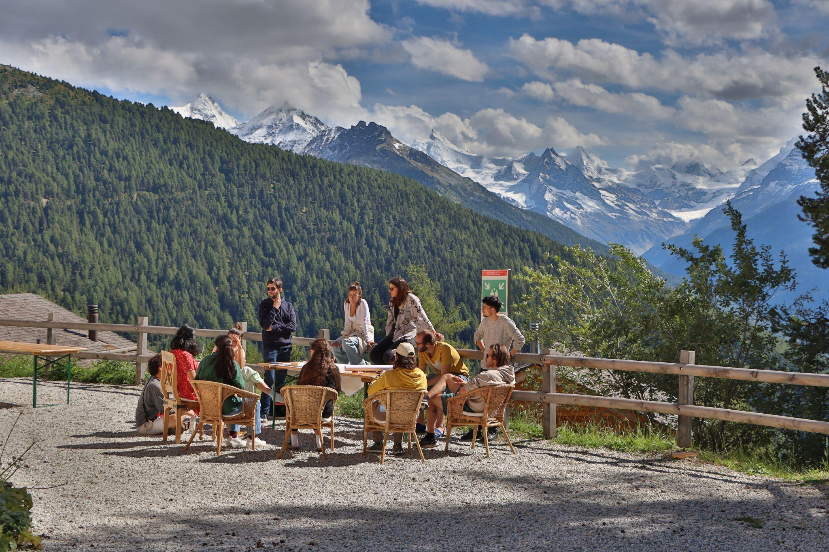
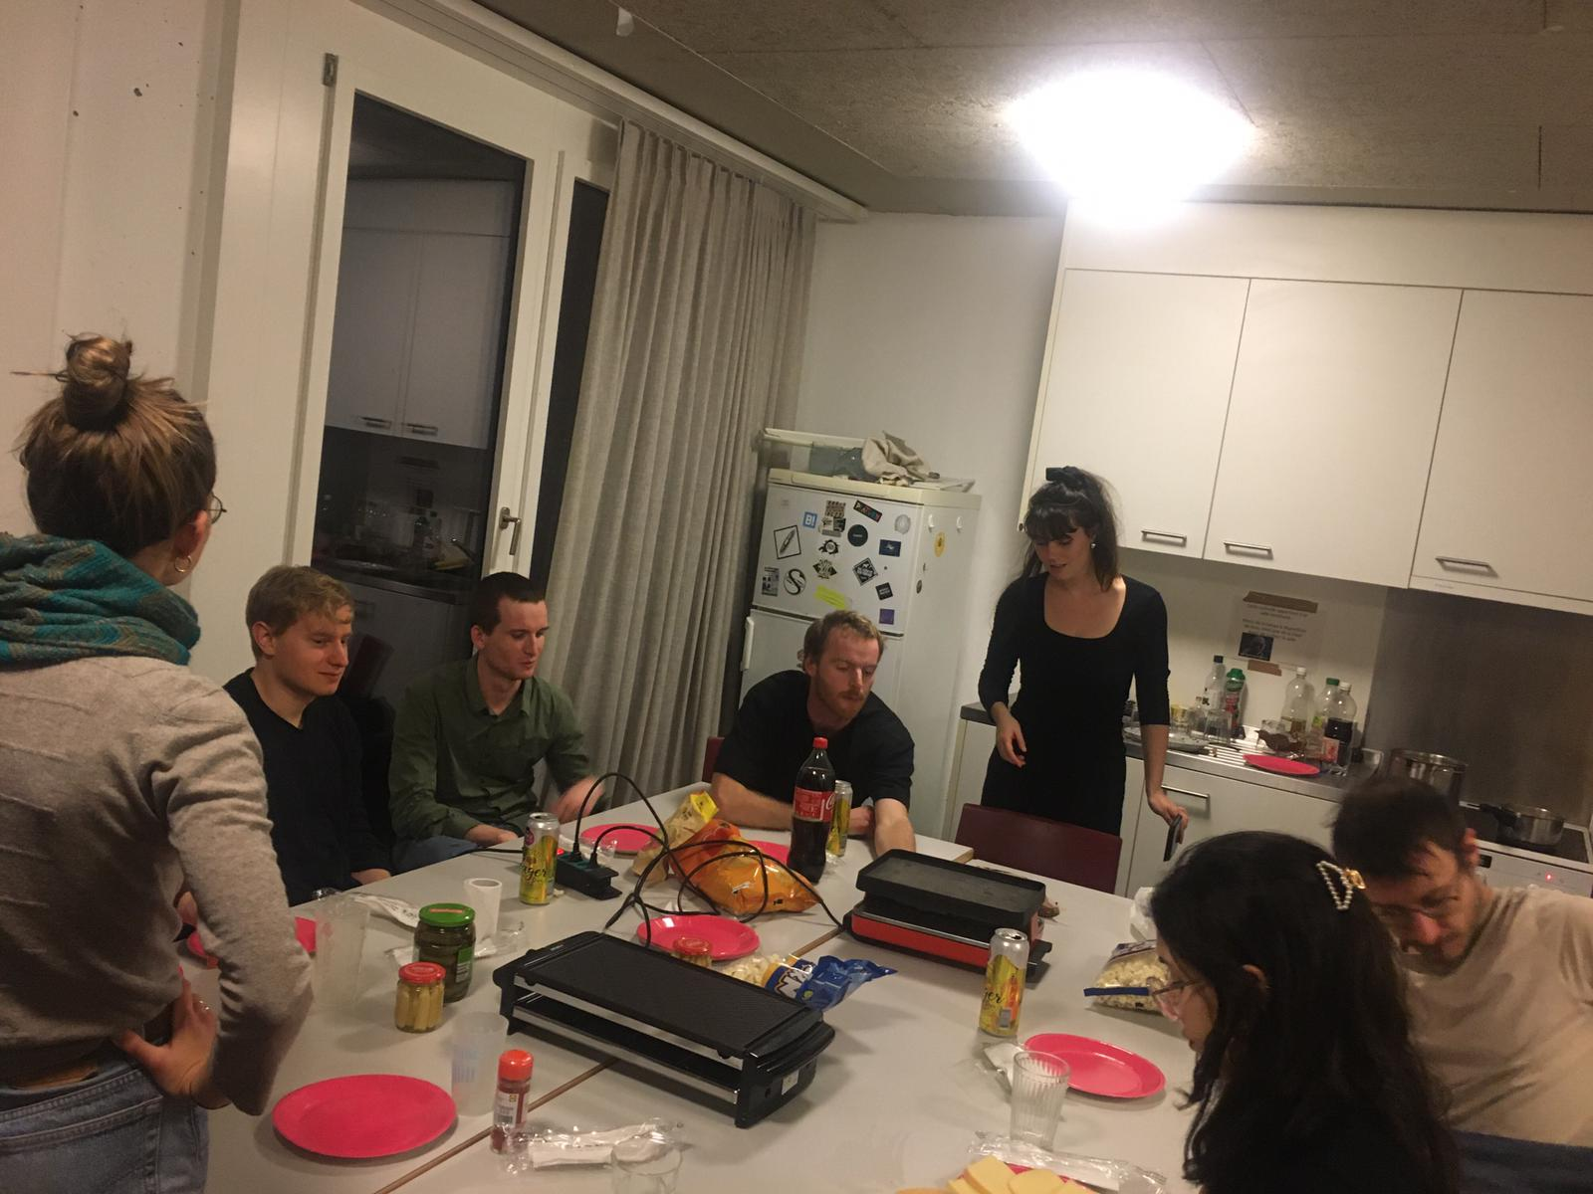
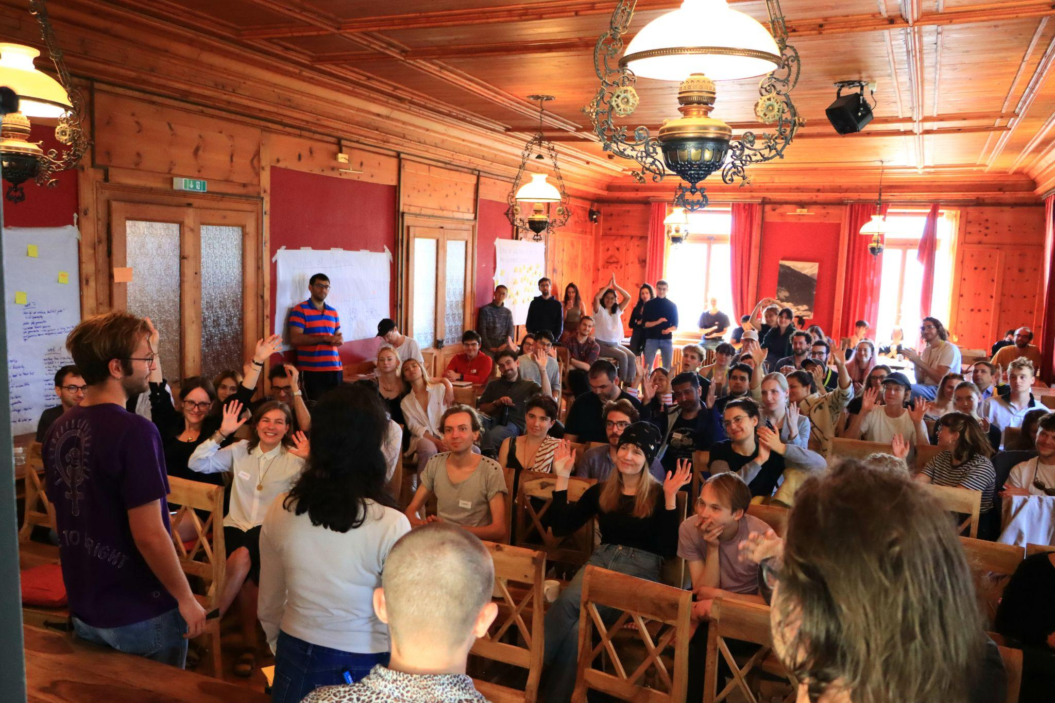
Autres activités
Notes:
Besides the work that comes with Rethinking Economics, this is also a good opportunity to connect with other pretty nice people either from other study programs here or around switzerland. Other Groups in Switzerland are doing pretty cool things as well: Lausanne Group did a study on the cost of masculinity in switzerland. And from RE Zürich the RE Summerschool emerged. Each year a few of us are going to the Rethinking Economics summer school - this picture is actually the birth of RE Geneva. We are trying to get together regularly for apero, we also had raclette once, also with alumnis. RE geneva is - what you make out of it. And I think with the connections and support we have - we can make pretty much out of it. For the next semester we count on your ideas - so I hope you already think about some projects. But there is two things that are fix already so please open your calendar and note:

Slide 8

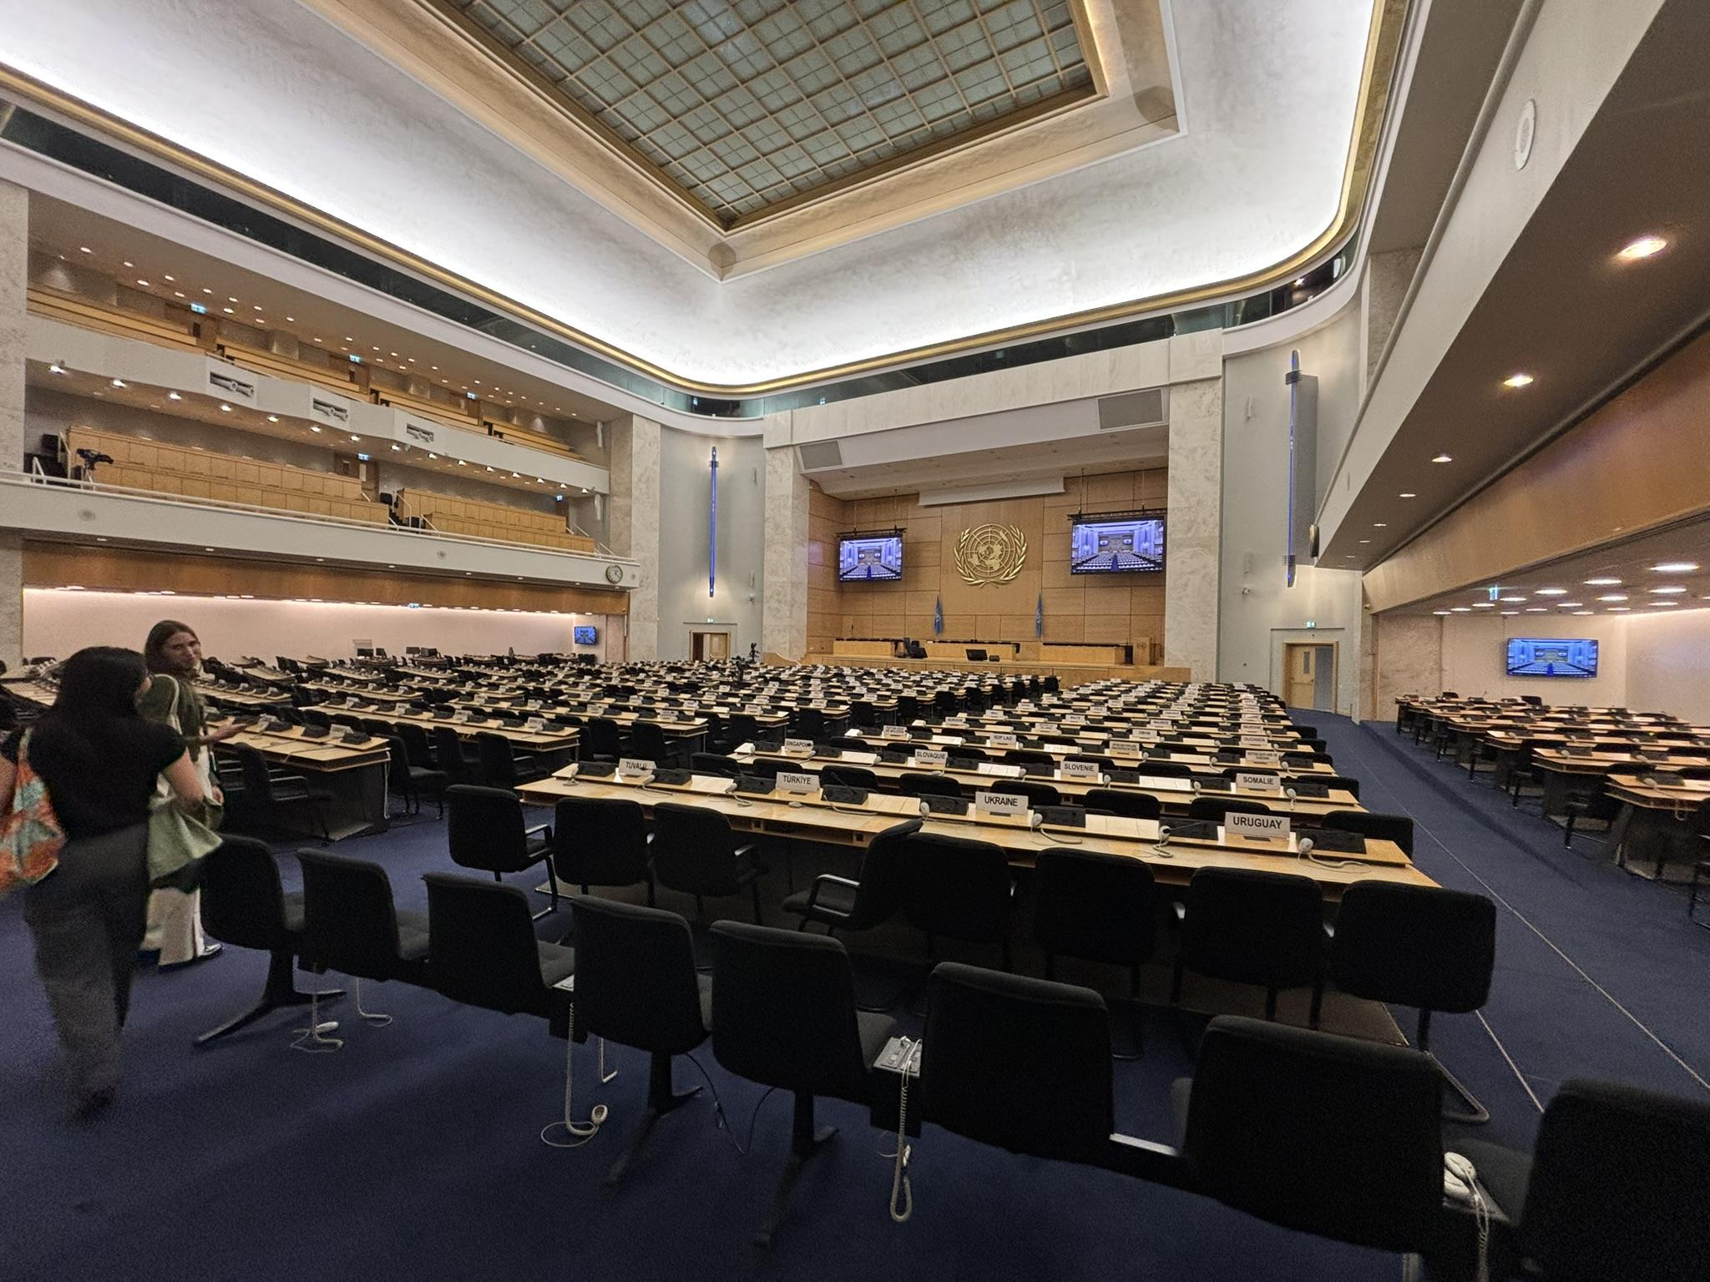
Next events
Forum des jeunes à la CNUCED16
20-23 octobre
Rethinking Economics Switzerland co-organise une session au Forum des jeunes de la CNUCED en octobre prochain.
La CNUCED, fondée par et pour les pays du Sud, a ouvert la voie à une réflexion hétérodoxe sur le commerce et le développement.
Le Forum des jeunes permet aux jeunes de faire entendre leur point de vue dans les débats politiques mondiaux. Les participants peuvent également assister à toutes les sessions de la CNUCED 16.
2. 1ère réunion RE Genève ce semestre
2 octobre, 6:15 p.m., M5220
Participez à notre première réunion le 2 octobre pour en savoir plus, partager vos idées et contribuer à façonner le semestre à venir.
Notes:
Carmen explains UNCTAD 16.
Rethinking Economics Switzerland is co-organizing a session at the UNCTAD Youth Forum this October, which takes place alongside the UNCTAD’s most important conference on trade and development.
UNCTAD (United Nations Conference on Trade and Development) was founded in the 1960s, when countries from the Global South came together to push back against dominant economic thinking and demand fairer rules in trade, finance and development. Since then, it has been a space where alternative and heterodox perspectives could enter international debates.
The Youth Forum is a gathering of students and young professionals to bring ideas and concerns into these discussions. What comes out of the forum feeds directly into the ministerial conference, where governments negotiate the priorities that will shape global economic policy in the years ahead.
Also, you can attend all other sessions of UNCTAD16.
If this is of interest to you, please join our second event, we our first meeting this semester will be 2nd of October. We will introduce all of this a bit more in detail, hope for your active participation and try to think together with you about the next semesters, and also you can bring your ideas. Join our first meeting on 2 October to learn more, share ideas, and help shape the semester ahead.
QR code for whats app, QR code for insta,

Slide 9
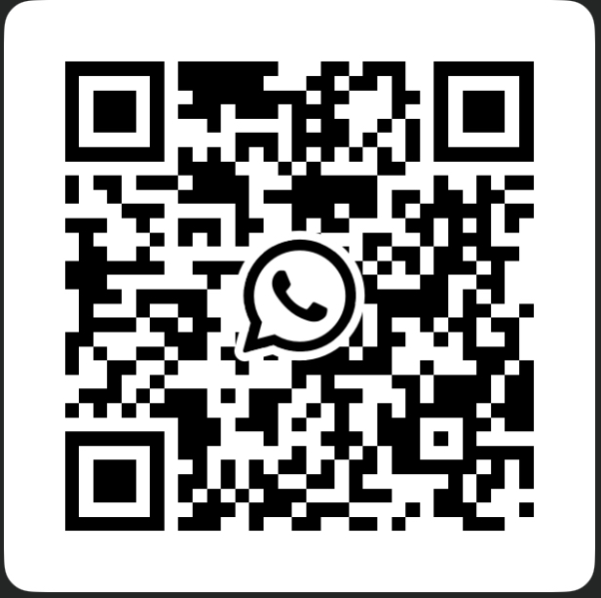
Rejoignez notre groupe WhatsApp

